Slide 1

Structural Design Patterns
By Ravi Kumar and Anil Kumar

Slide 2

What are Design Patterns? Design patterns are typical solutions to commonly occurring problems in software design. They are like pre-made blueprints that you can customize to solve a recurring design problem in your code.
Why should we learn patterns?
Design patterns define a common language that you and your teammates can use to communicate more efficiently.
Design patterns are a toolkit of tried and tested solutions to common problems in software design.

Slide 3

Structural Design Pattern
A structural design pattern is a reusable solution that addresses the organization and relationships between classes and objects in a software system. These patterns help ensure that the components of a system are properly structured, promoting flexibility, reusability, and maintainability.
Structural design patterns focus on how classes and objects are composed to form larger structures or relationships. They provide mechanisms for creating relationships between objects, allowing them to work together in a cohesive manner.

Slide 4
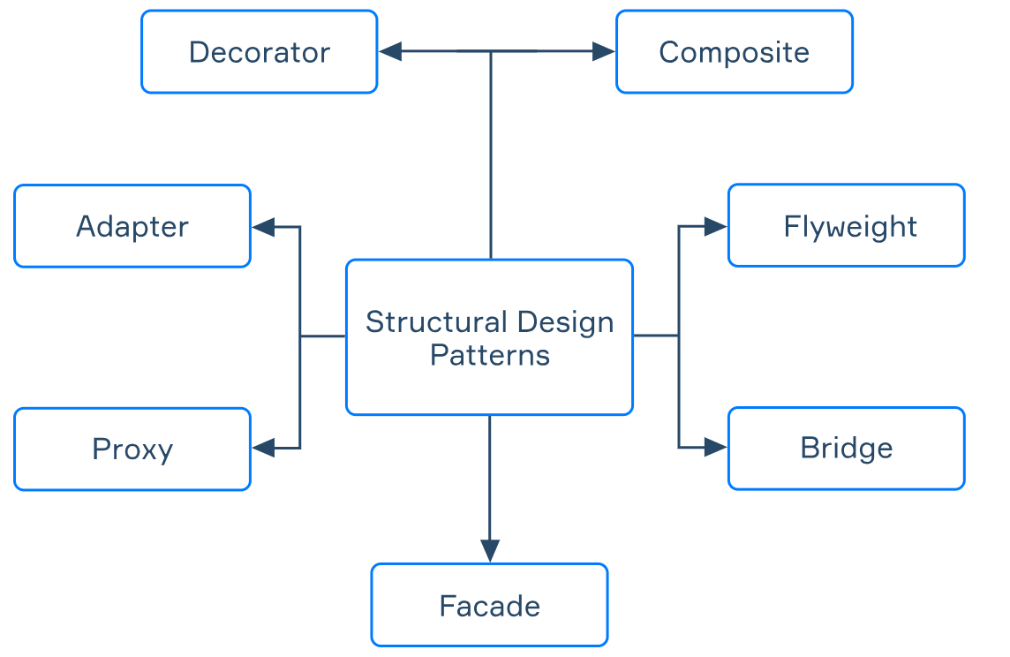

Slide 5
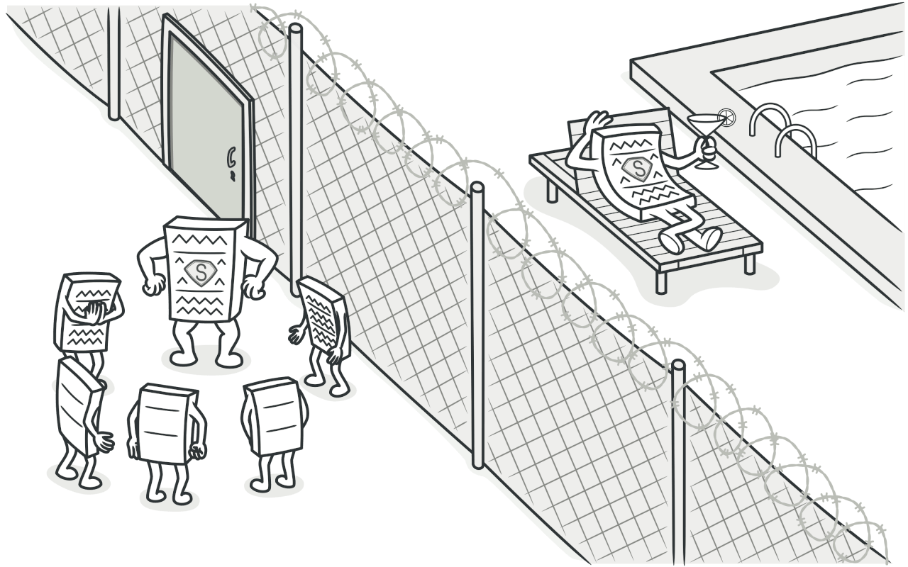
Proxy Pattern
Proxy is a structural design pattern that lets you provide a substitute or placeholder for another object.
A proxy controls access to the original object, allowing you to perform something either before or after the request gets through to the original object.
The purpose of the Proxy pattern is to add an extra level of indirection to control or enhance the behavior of the underlying object.

Slide 6
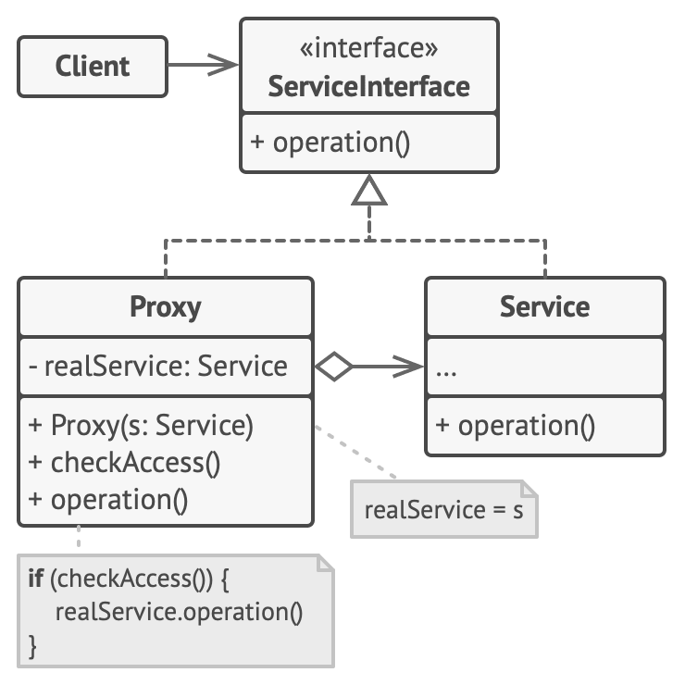
Structure

Slide 7
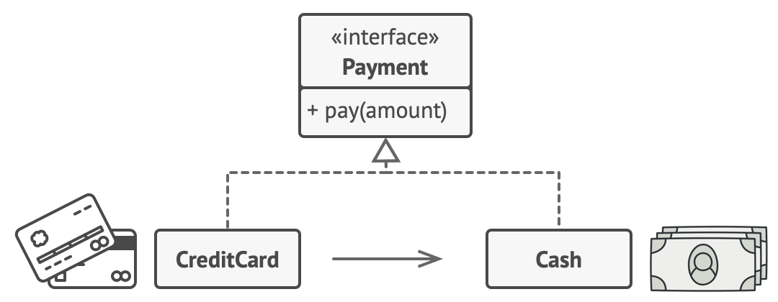
Example
A credit card is a proxy for a bank account, which is a proxy for a bundle of cash. Both implement the same interface: they can be used for making a payment. A consumer feels great because there’s no need to carry loads of cash around. A shop owner is also happy since the income from a transaction gets added electronically to the shop’s bank account without the risk of losing the deposit or getting robbed on the way to the bank.

Slide 8
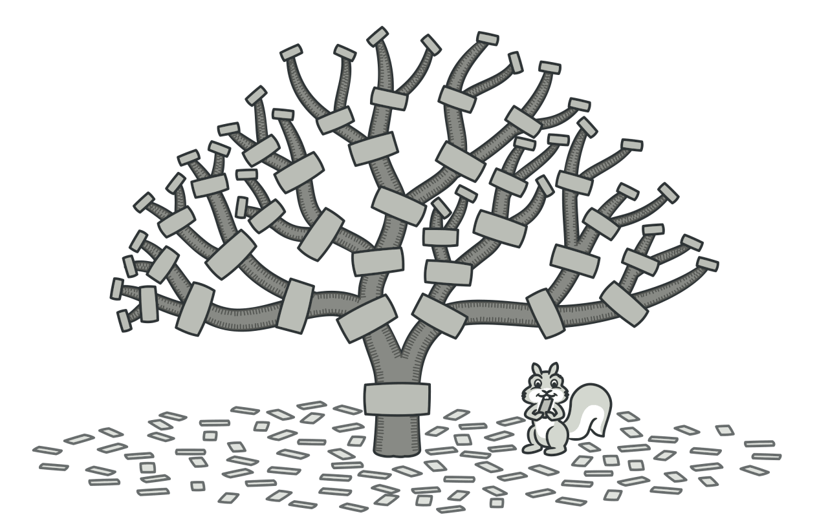
Composite Pattern
Composite is a structural design pattern that lets you compose objects into tree structures and then work with these structures as if they were individual objects.
The purpose of the Composite pattern is to provide a unified way of accessing and manipulating individual objects and groups of objects, enabling clients to work with them in a consistent manner.

Slide 9
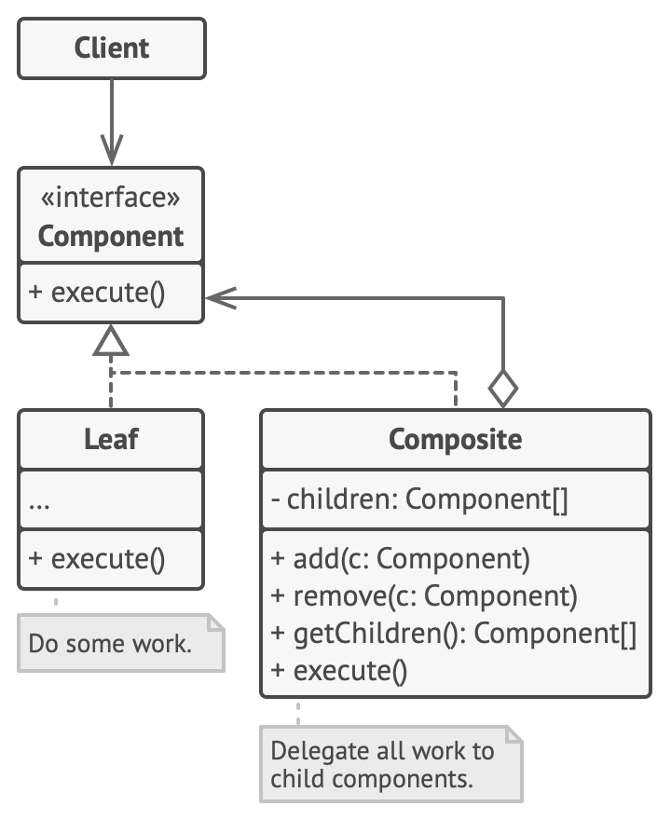
Structure

Slide 10
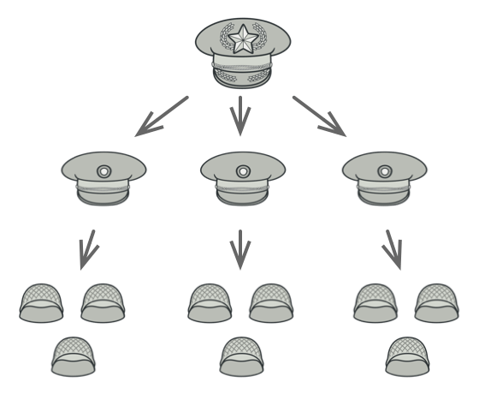
Example
Armies of most countries are structured as hierarchies. An army consists of several divisions; a division is a set of brigades, and a brigade consists of platoons, which can be broken down into squads. Finally, a squad is a small group of real soldiers. Orders are given at the top of the hierarchy and passed down onto each level until every soldier knows what needs to be done.

Slide 11
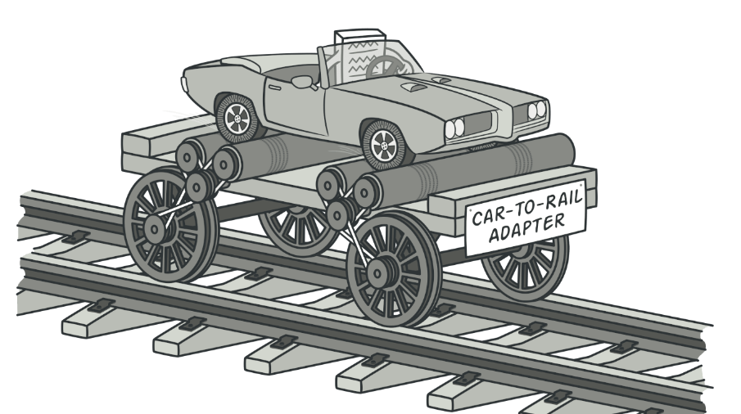
Adapter Pattern
Adapter is a structural design pattern that allows objects with incompatible interfaces to collaborate.
It acts as a bridge between two incompatible classes, making them compatible without changing their existing interfaces.
The purpose of the Adapter pattern is to enable communication and collaboration between objects that would otherwise be unable to work together due to incompatible interfaces.

Slide 12
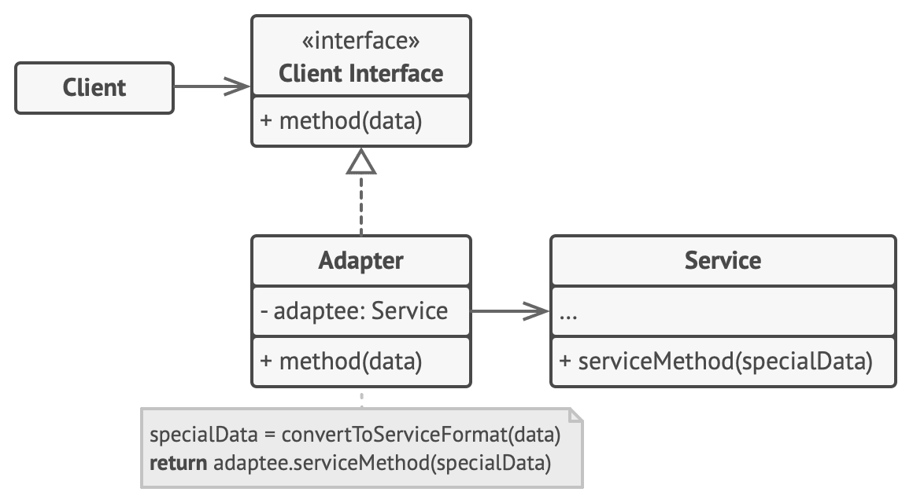
Structure

Slide 13
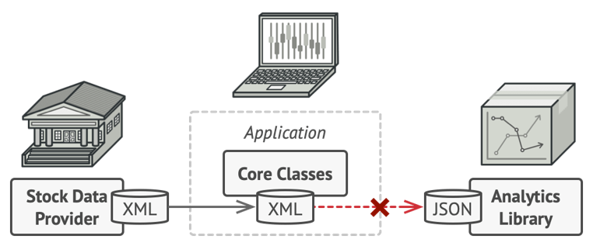
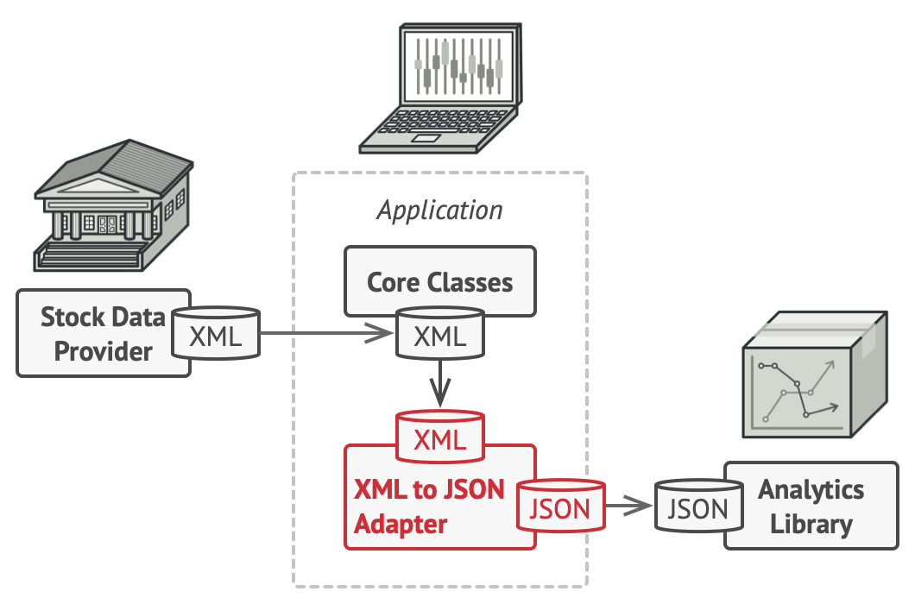
ExAMplE Problem Solution

Slide 14
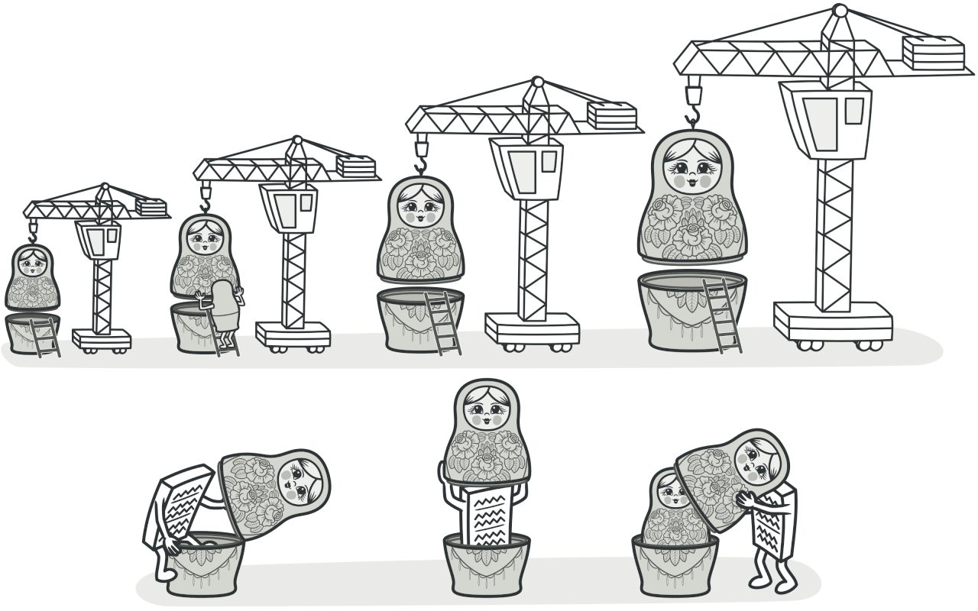
Decorator Pattern
Decorator is a structural design pattern that lets you attach new behaviors to objects by placing these objects inside special wrapper objects that contain the behaviors.
The purpose of the Decorator pattern is to enhance the capabilities of individual objects by wrapping them with one or more decorators that add additional features.

Slide 15
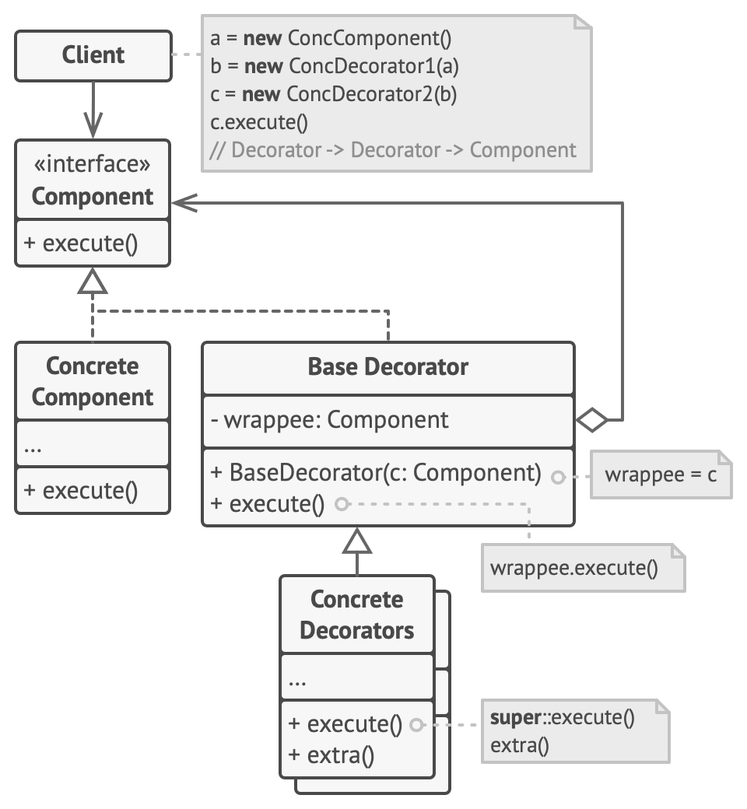
Structure

Slide 16
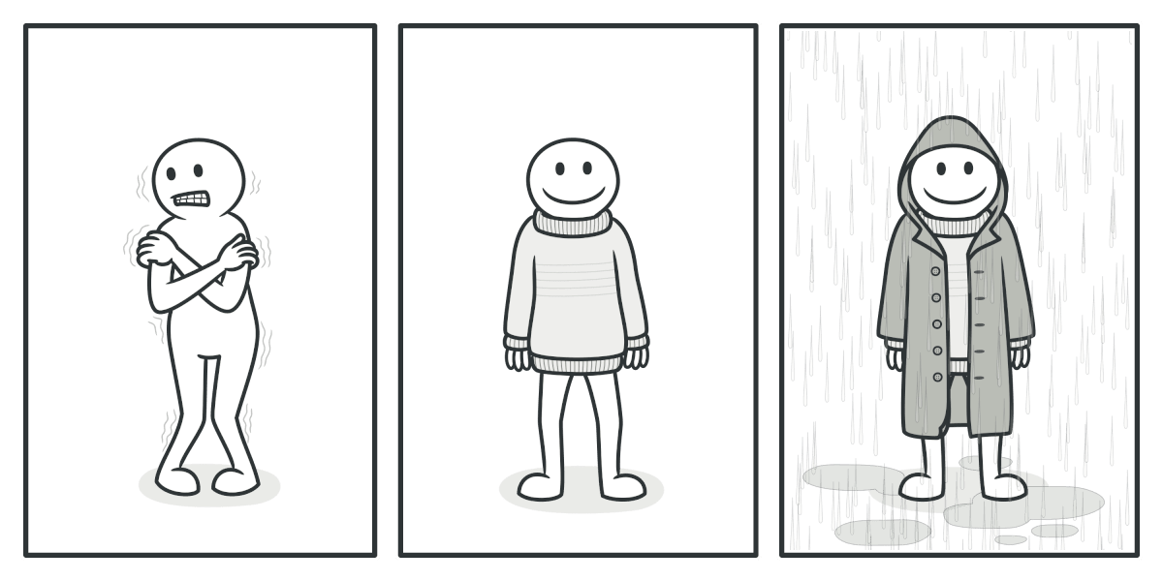
Example
Wearing clothes is an example of using decorators. When you’re cold, you wrap yourself in a sweater. If you’re still cold with a sweater, you can wear a jacket on top. If it’s raining, you can put on a raincoat. All of these garments “extend” your basic behavior but aren’t part of you, and you can easily take off any piece of clothing whenever you don’t need it.

Slide 17
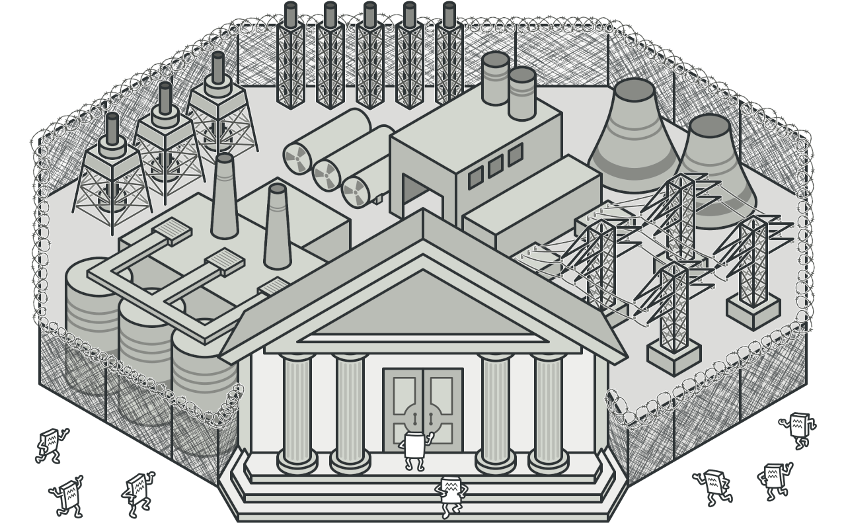
Façade Pattern
Facade is a structural design pattern that provides a simplified interface to a library, a framework, or any other complex set of classes.
It acts as a high-level interface that hides the complexities of the underlying system and provides a unified interface for clients.
The purpose of the Facade pattern is to simplify the usage and interaction with a complex system by providing a single entry point.

Slide 18
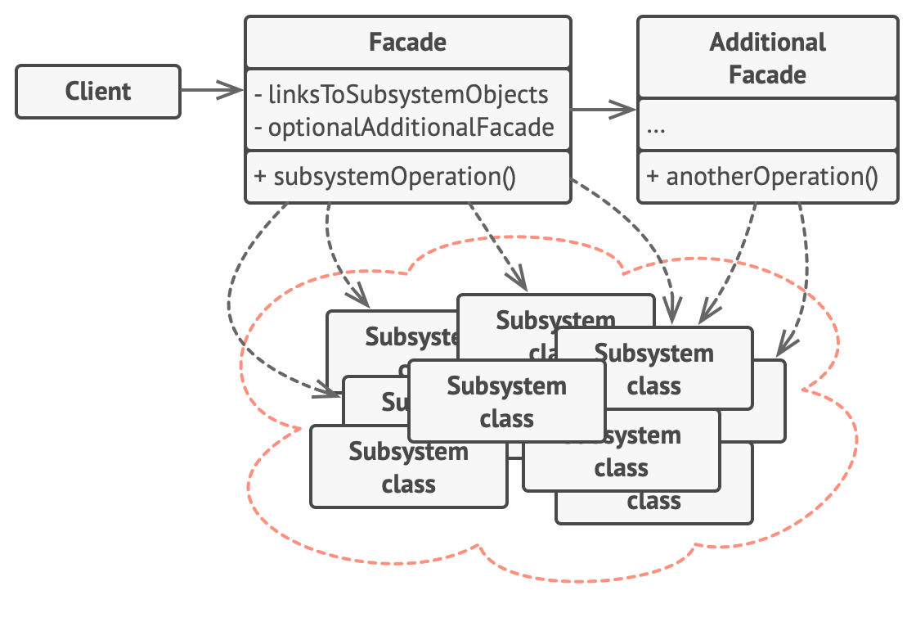
Structure

Slide 19
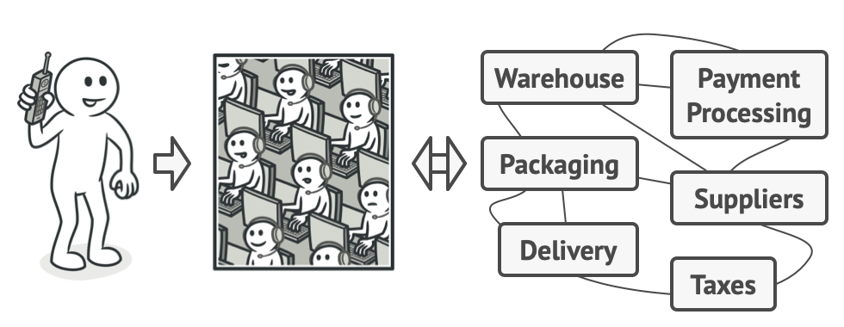
Example
When you call a shop to place a phone order, an operator is your facade to all services and departments of the shop. The operator provides you with a simple voice interface to the ordering system, payment gateways, and various delivery services.

Slide 20
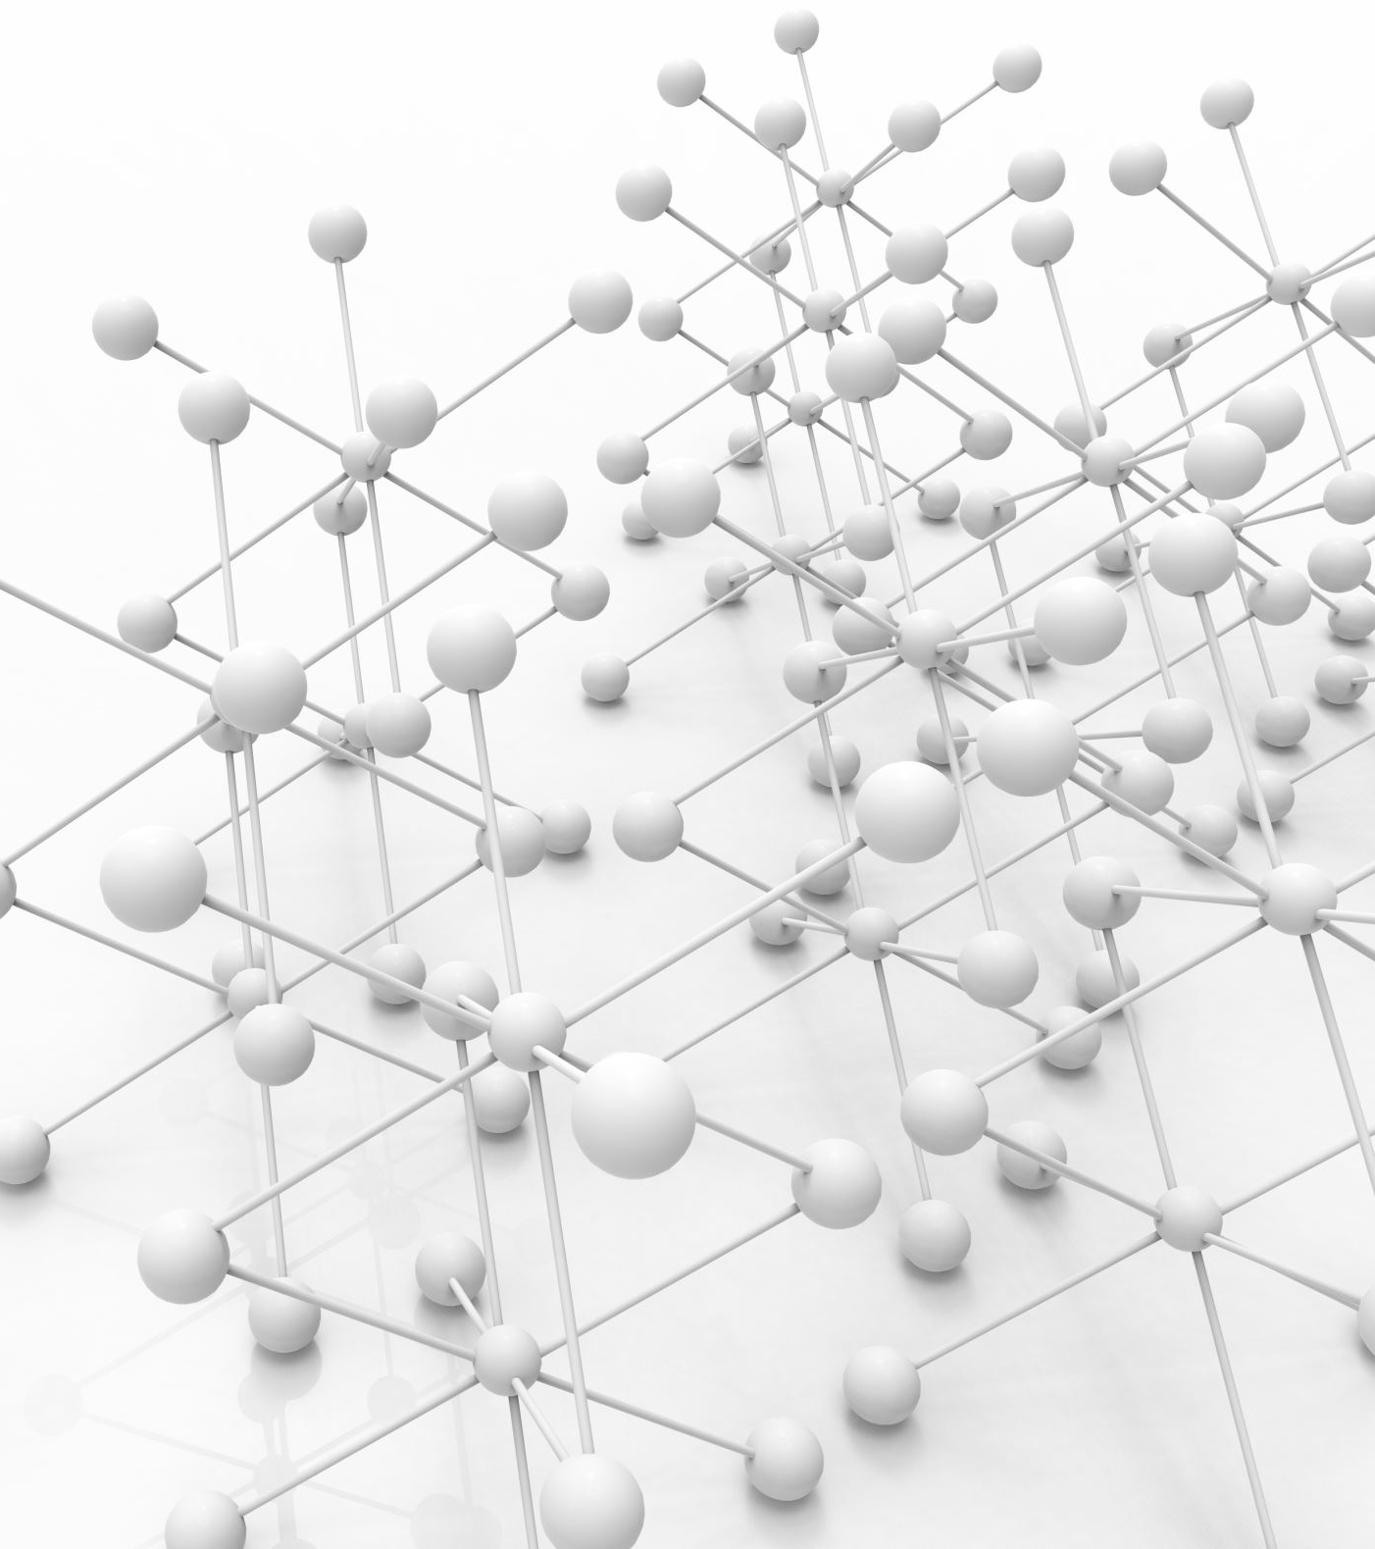
Coclusion
In conclusion, structural design patterns play a crucial role in organizing classes and objects within a software system. They provide solutions to common design problems and help achieve software that is flexible, maintainable, and extensible.
By using structural design patterns, developers can:
Promote code reusability
Simplify system complexity
Enable flexibility and extensibility
Improve code scalability
Enhance code maintainability

